Slide 1
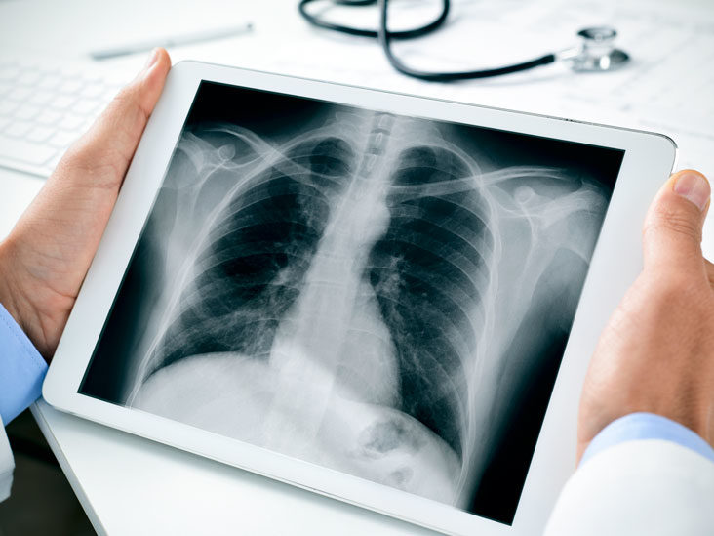
COVID-19 Radiography Database
Machine Learning II
Spring 2021
Sertan Akinci
Kristin Levine

Slide 2
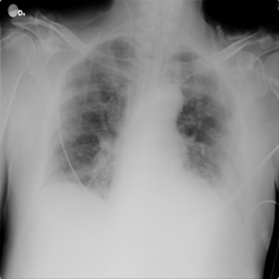
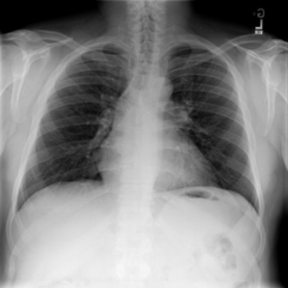
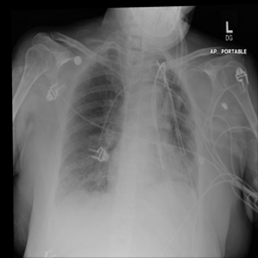
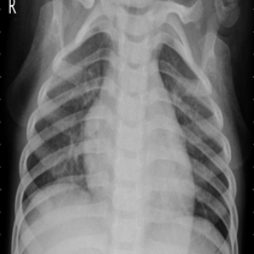
Description of the Dataset
The COVID-19 Radiography Database is a large collection of four different classes of chest X-rays. 21,165 images -all .png format with resolution 299 x 299 pixels
COVID-19
3616 images
Normal
10,192 images
Lung Opacity
6012 images
Viral Pneumonia
1345 images

Slide 3
Why this problem?
In the midst of the pandemic, it is more important than ever to be able to quickly diagnose and treat different types of lung infections
At a time when medical staff is greatly overworked, it would be wonderful if machine learning could help in making some of these diagnoses.

Slide 4
Dataset - Splitting Data
Put aside a test set - 10% from each class
Remaining data 80% training and 20% validation
Unbalanced classes:
COVID-19 | 3,254
Normal | 9,173
Lung Opacity | 5,410
Viral Pneumonia | 1,210

Slide 5
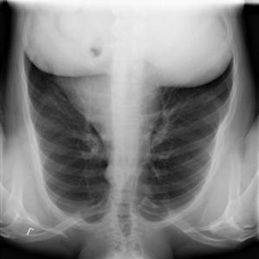
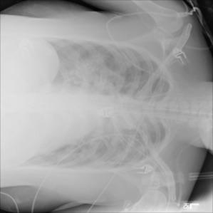
Dataset - Over/Under Sample and Augment

Slide 6
Dataset - Balanced Data
With augmentation and undersampling:
COVID-19 | 4,476
Normal | 5,137
Lung Opacity | 5,411
Viral Pneumonia | 4,844

Slide 7
Experimental Setup
Previous research - 2 or 3 classes
All 4 categories; three different pre-trained models:
ResNet50
Xception
VGG16
Ensemble models together using random forest algorithm

Slide 8
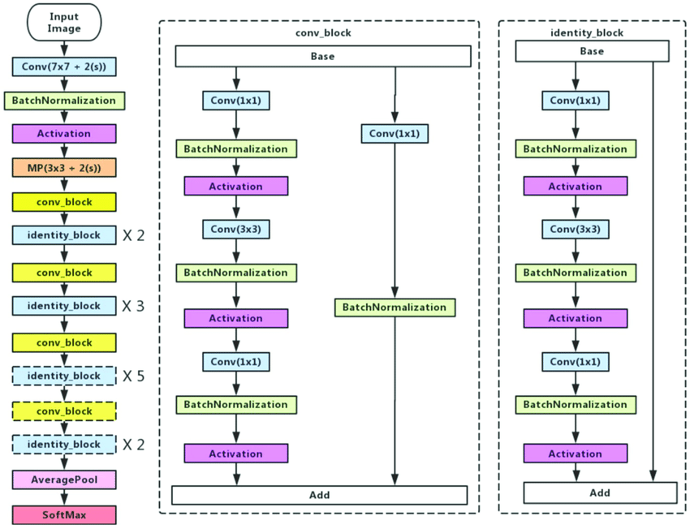
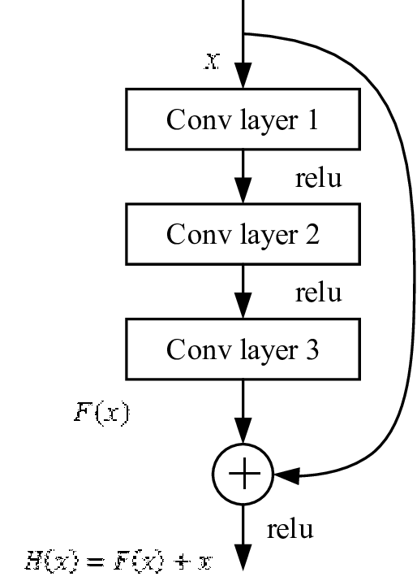
Pretrained Model - Resnet50

Slide 9
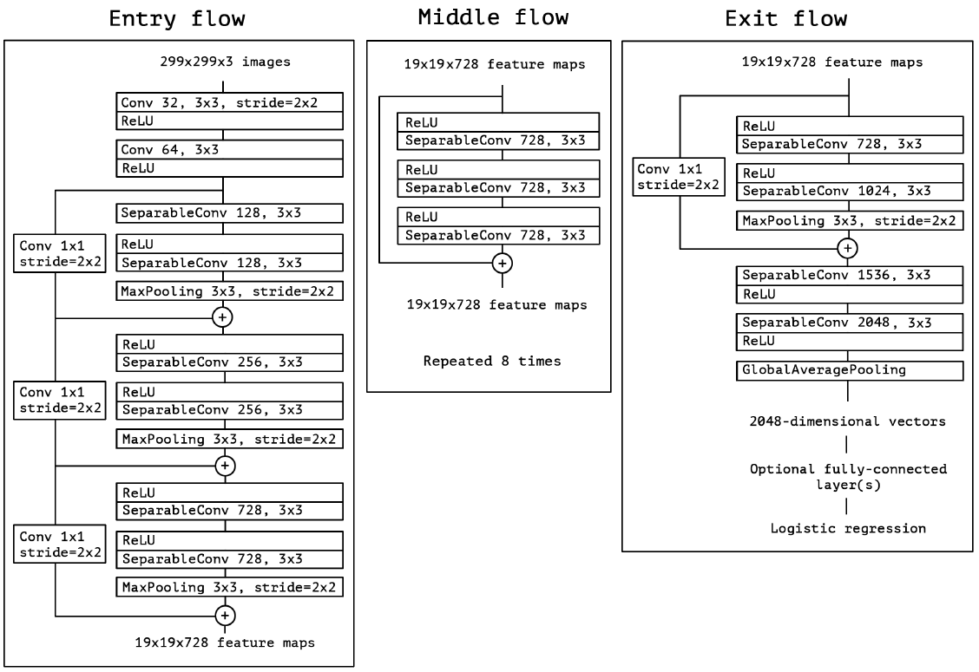
Pretrained Model - Xception

Slide 10
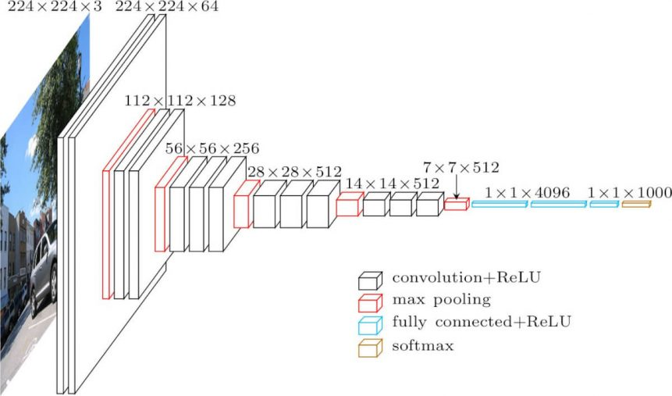
Pretrained Model - VGG16

Slide 11
Loading data
Used Tensorflow’s image_dataset_from_directory
It labels data based on folders structure,
Can splits, batch, interpolate when resizing and can specify color channel
data_tr = tf.keras.preprocessing.image_dataset_from_directory(
data_folder, labels='inferred', class_names=None,
color_mode='rgb', batch_size=batch, image_size=img_size, seed=random_seed,validation_split=split,
subset='training', interpolation='bilinear')

Slide 12
Training & Parameters
Tried freezing pretraining layers (lr = 0.001) and then unfreezing (lr =0.0001)
Also tried training entire model along with pre-trained layers (lr = 0.0001)
Both ways were effective !!
Also experimented with different optimizer, Adam and SGD with momentum = 0.9

Slide 13
Overfitting/Early stopping
If training accuracy higher than validation accuracy:
Overfitting -- addressed with dropout layer
EarlyStopping -- can use high number of epochs

Slide 14
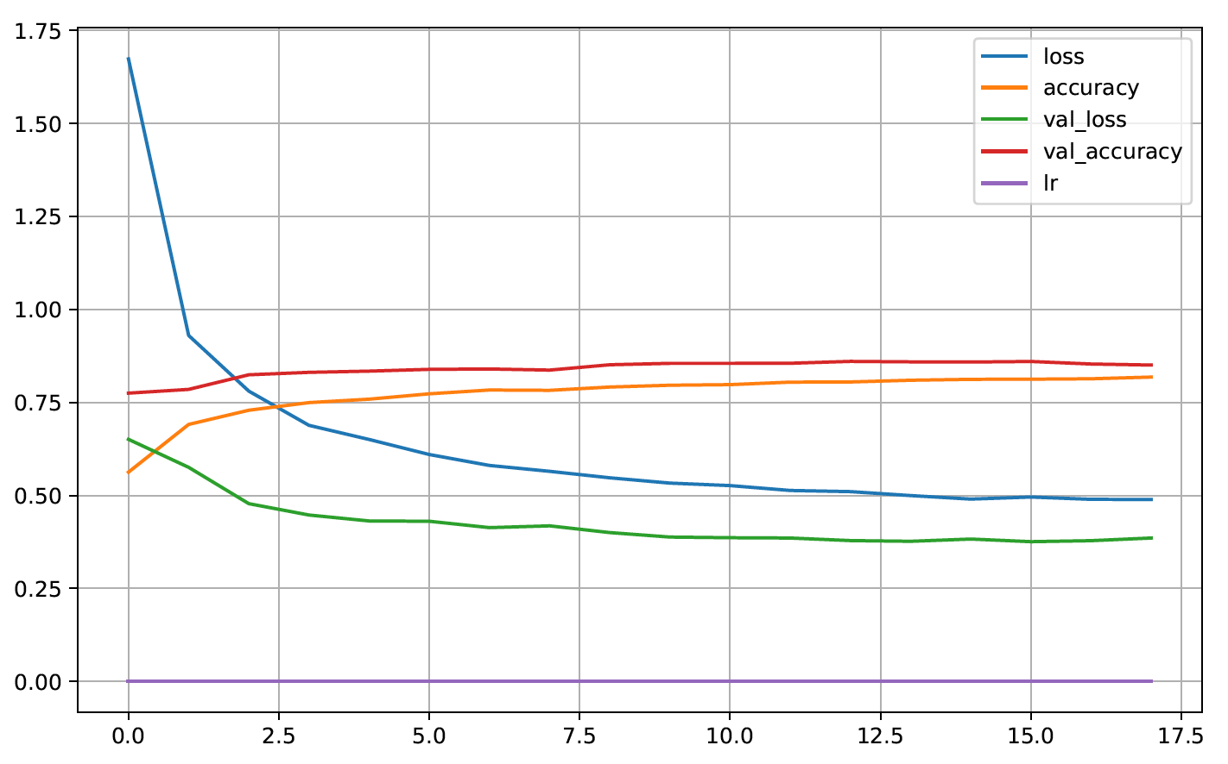
Evaluating models:
Graphed loss and accuracy vs epoch
Also looked at precision, recall, and f1-score

Slide 15
Initial Results:
Training and Validation accuracy for all three models was over 90%, but for the test data it wasn’t!
RESNET TEST DATA precision recall f1-score support
COVID 0.16 0.16 0.16 192
Lung_Opacity 0.31 0.30 0.30 319
Normal 0.49 0.50 0.49 541
Viral Pneumonia 0.08 0.08 0.08 71
Accuracy : 35.61887

Slide 16
Random Forest
Classification Report:
precision recall f1-score support
COVID 0.12 0.06 0.08 52
Lung_Opacity 0.28 0.21 0.24 98
Normal 0.50 0.72 0.59 163
Viral Pneumonia 0.00 0.00 0.00 24
Accuracy : 42.13649851632047

Slide 17
Loading test data wrong!
y_resnet = np.concatenate([y for x, y in test_data_resnet], axis=0)
And got this:
[2 2 2 ... 0 1 2]
y_xcept = np.concatenate([y for x, y in test_data_xcept], axis=0)
And got this:
[0 2 1 ... 0 1 2]

Slide 18
Corrected Testset - ResNet & Xception:
RESNET precision recall f1-score support
COVID 0.93 0.98 0.16 316
Lung_Opacity 0.93 0.89 0.30 601
Normal 0.93 0.95 0.49 1019
Viral Pneumonia 0.95 0.94 0.08 134
Accuracy : 93.8573423
XCEPTION precision recall f1-score support
COVID 0.91 0.98 0.16 316
Lung_Opacity 0.90 0.89 0.30 601
Normal 0.95 0.95 0.49 1019
Viral Pneumonia 0.95 0.94 0.08 134
Accuracy : 90.2127659

Slide 19
Corrected VGG16 / Random Forest
VGG16 precision recall f1-score support
COVID 0.94 0.99 0.96 316
Lung_Opacity 0.92 0.92 0.92 601
Normal 0.95 0.94 0.95 1019
Viral Pneumonia 0.99 0.90 0.95 134
Accuracy : 94.2316478
Random Forest precision recall f1-score support
COVID 0.98 0.99 0.99 112
Lung_opacity 0.93 0.90 0.92 167
Normal 0.95 0.97 0.96 318 Viral Pneumonia 0.97 0.97 0.97 38
Accuracy : 95.118621102
Ensembled
Model
Performed
the best!

Slide 20
Conclusions
90-93% accuracy when classifying four different types of chest X-ray images; Covid, Normal, Lung Opacity, and Pneumonia
94% accuracy using Random Forest model by linking all our models together.
Ensembling models is definitely a technique we’ll continue to use in the future.
Not freezing the pre-trained models performed better than expected
Augmentation did not help as expected

Slide 21
Future Improvements
if we had to do it again, we might consider separating the data into less categories like Normal, COVID, and Other
If we were only interested in correctly identifying COVID infections (since that is a new type of infection that clinicians might have less experience with) it might make sense to lump the other types of infections into one category.
Finally, it would also be interesting to use different types of models -- as the ones we selected performed fairly similarly.
Could be turned into a software that health care providers can utilize anywhere in the world

